Slide 1


for
Notes:
Welcome to today’s lecture
It will be about Kendo UI for Vue
Wrapper components
Who is this training for
Technical stuff/issues introduce team
Submit questions about Kendo to using the submit question function
Either myself or my team will answer them and if I can I will address the question during the presentation
Materials available: https://github.com/newventuresoftware/kendo-ui-for-vue

Slide 2

{Welcome to Progress Virtual Classroom}
Notes:
Progress has a long history of providing tools to make developers happy and successful.
That’s why, when looking new ways to bring value to the customers and thank them for their loyalty, training came to mind.
We understand developers have a choice when it comes to selecting a UI vendor – and we believe that when users decide to partner with Progress, they are getting the very best UI, the very best support and now the very best training at no additional out of pocket expense.
I’m proud to welcome you to the Virtual Classroom, a free training program for Telerik active license holders.

Slide 3
Date | Time | Course
June 26, 2018 | 9am - 1pm EST | Kendo UI & Angular
June 27, 2018 | 9am - 1pm EST | Kendo UI & jQuery
July 10, 2018 | 9am - 1pm EST | Telerik UI for ASP.NET MVC and ASP.NET Core
July 11, 2018 | 9am - 1pm EST | Kendo UI & Vue
July 12, 2018 | 9am - 1pm EST | Kendo UI & React
July 13, 2018 | 9am - 1pm EST | Telerik UI for Xamarin
July 16, 2018 | 9am - 1pm EST | Telerik UI for WPF
July 17, 2018 | 9am - 1pm EST | Telerik Reporting & Telerik Report Server
July 19, 2018 | 9am - 1pm EST | Telerik UI for ASP.NET AJAX
July 24, 2018 | 9am - 1pm EST | Telerik UI for WinForms
July 26, 2018 | 9am - 1pm EST | Telerik UI for UWP
Notes:
With more than 30 hours of technical content created in partnership with New Venture Software, Virtual Classroom is designed to quickly get you onboard and successful with our developer tools whether you’ve been using them for years or are new to the suite. Each session will provide practical knowledge combined with helpful approaches to application development.
Here you can seen on your screens the schedule for the second season of trainings.
Web:
-Kendo UI fully covered
-MVC & Core
-Ajax
Desktop:
-WPF
-Winforms
-UWP
Mobile:
-Xamarin
Business intelligence:
-Reporting and Reporting Server
With this in mind it is important for us to receive your feedback and let us know if we can improve anything for the next iteration. Feel free to submit your feedback as we move along in the form of a question or contact me personally by email.
The recorded on-demand training videos, slides and demos will be available shortly after the corresponding live training is complete, and all training sessions will be refreshed after each major release. You'll also have access to all the training materials including slides and demos.

Slide 4









Vladimir Milev
Chief Software Architect @
vladi@newventuresoftware.com
github.com/vmilev
vmilev
Notes:
-Read the basic info on the slide
-Great history with Telerik & Progress
-Invite to follow on twitter and on the newventuresoftware blog

Slide 5
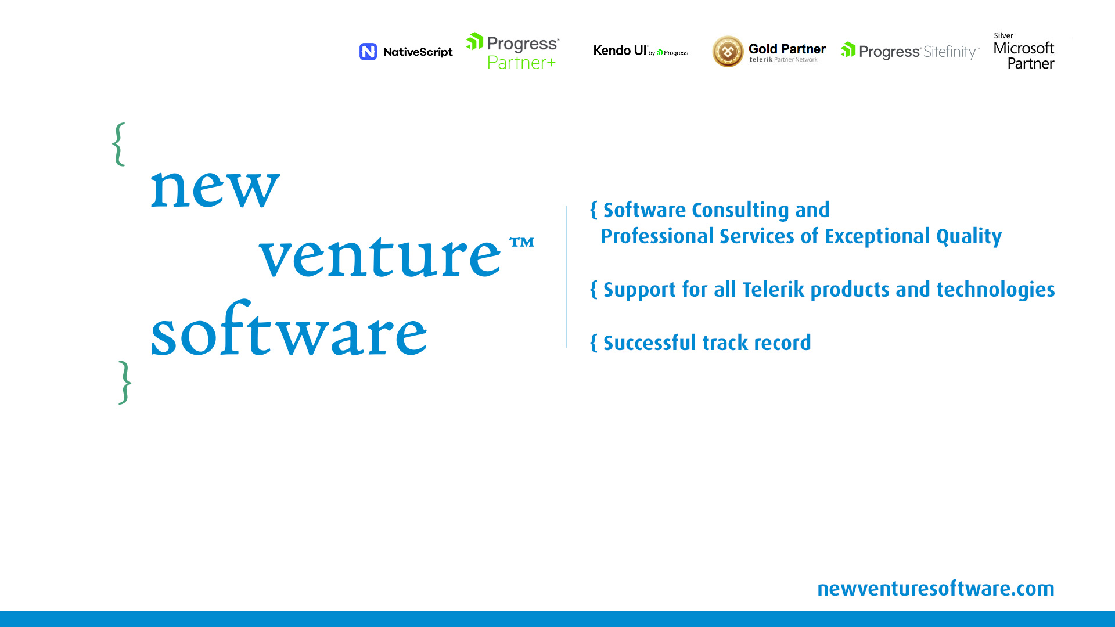
Notes:
We are a premium consulting and professional services partner for Progress Telerik products and technologies, who’s been instrumental in building the award-winning DevCraft suite.
The exceptional quality of our consulting and professional services stems from a solid background and expertise in Telerik DevCraft. Most of us are ex-Progress Telerik software architects who have led a number of teams building the Telerik DevCraft suite.
We support all progress Telerik products and technologies be it for the web, desktop or mobile and have a successful track record of delivering future-proof software consulting and development solutions.
My teammates and I feel honored and excited to have the opportunity to share with you our experience and passion about the Telerik technologies.

Slide 6

{Agenda}
Why choose Vue.js
Vue Compared to other frameworks
Obtaining Vue.js
Vue library deep dive
Kendo UI for Vue
Live demo
Theme builder and other resources

Slide 7

{Let’s Start}
Sit back and get comfortable

Slide 8

Wait, wait! Aren’t there already….
Notes:
There are indeed a lot of web development frameworks that popped up in the past few years.
However, things are starting to mature and the market is settling on a few big ones. For that reason the Kendo UI team has decided to support what they believe are the major ones such as: React, Angular and you guessed it – Vue
This presentation is about Vue, but I will discuss how it compares with Angular and React

Slide 9

{Why Vue.js?}
Easy to learn
Easy to develop
Easy to maintain
Fast!
Start fast (size)
Run fast (virtual DOM)
Why Gitlab chose Vue
Notes:
The biggest strength of Vue in my opinion is it’s simplicity
Managed to start working with Vue in 2-3 days.
Maintenance is easy because: vue simplicity, mvvm
Fast download compared to angular/react
Virtual Dom – based on snabbdom; Dom manipulation is slow thus virtual dom speeds it up; It is smart about what it updates

Slide 10


{Vue compared to Angular}
Angular has TypeScript as language of choice (docs are in TS, using it without TS is a challenge); Vue offers choice
Angular is more opinionated
Angular has a steeper learning curve
Vue is smaller in size (~30KB vs ~130KB)
Angular CLI is has more features
Angular is targeted for large, enterprise-level apps
Notes:
-To learn more about Angular check out Denis Kyashif’s training on Kendo UI for Angular

Slide 11

{Vue compared to React}
Both frameworks are very similar
Both frameworks are exceptionally fast
React uses JSX instead of templates
React is more popular and has a richer ecosystem
React has a somewhat steeper learning curve
React is not just for the web, Vue is mostly web
Notes:
They both:
utilize a virtual DOM
provide reactive and composable view components
maintain focus in the core library, with concerns such as routing and global state management handled by companion libraries
In React, everything is just JavaScript. Not only are HTML structures expressed via JSX, the recent trends also tend to put CSS management inside JavaScript as well. This approach has its own benefits, but also comes with various trade-offs that may not seem worthwhile for every developer. Vue embraces classic web technologies and builds on top of them.
Vue also has render functions and support for JSX, but the default experience of templates is simpler to use.
For many developers who have been working with HTML, templates feel more natural to read and write. The preference itself can be somewhat subjective, but if it makes the developer more productive then the benefit is objective.
HTML-based templates make it much easier to progressively migrate existing applications to take advantage of Vue’s reactivity features.
It also makes it much easier for designers and less experienced developers to parse and contribute to the codebase.
You can even use pre-processors such as Pug (formerly known as Jade) to author your Vue templates.

Slide 12



{Tools we will need - 1}
Node.js
https://nodejs.org/en/download/current/
VSCode
https://code.visualstudio.com/
GitHub
https://git-scm.com/downloads
https://github.com/newventuresoftware/kendo-ui-for-vue
Notes:
A big part of today’s training will be coding/demos.
If you are hands of kind of guy and want to follow along with me these are the tools I will be using today.
These are by no means the only tools you can use, just my choice of software.
Also, I think this is a pretty good collection to start learning and working with Vue!

Slide 13
{Tools we will need - 2}
LiveServer
npm install –global live-server
Vetur for VSCode
https://github.com/vuejs/vetur
Devtools for Vue (Chrome extension)
https://chrome.google.com/webstore/detail/vuejs-devtools/nhdogjmejiglipccpnnnanhbledajbpd

Slide 14
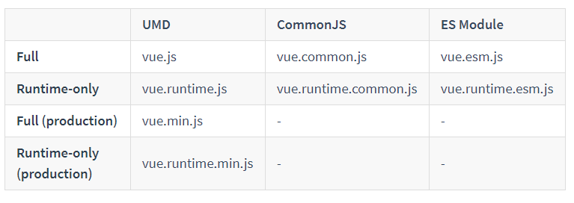
{Getting Vue}
Obtaining Vue
Download @ https://vuejs.org/js/vue.min.js
CDN @ https://unpkg.com/vue
NPM npm install -g vue

Slide 15
{Hello, Vue - Demo}
Let’s see Vue in action for the first time!
Notes:
Including Vue in our HTML
Creating the Vue instance – called Vue/View
Mounting the Vue instance to an HTML element. HTML and Body tags are not supported because of vdom implementation.
Setting up the data object
Using a declarative template binding to show data
Using the Vue Devtools to inspect the Vue
Observability of the data object -> properties in data object are made observable
Scope of the Vue

Slide 16

{Short Break}
Please take ~10 minutes to relax and recharge

Slide 17

{Vue.js Deep Dive}
An overview of the most important features of the Vue.js library
Notes:
We are going to take a look at some of the most important features of Vue
This is by no means an exhaustive list
Even the features we look at will not be explored to their fullest extent
There are many additional advanced features for animations, styling and visual appearance

Slide 18
{Template bindings - Demo}
Template bindings are one-way
Can insert content via moustaches {{}} & The v-text directive
Could have one-time bindings with the v-once directive
Raw HTML can be inserted with v-html directive
Bindings support inline javascript expressions
Attribute binding is also supported with v-bind
CSS property and class bindings have extended support

Slide 19
{Input bindings - Demo}
Input elements are bound via the v-model directive
Bindings with v-model are two-way
Vue has support for variety of single-input and select elements
Binding modifiers: .number .lazy .trim

Slide 20
{Handling events}
Events are subscribed with the v-on directive (shorthand @)
Could be handled both inline and in a handler method
The Vue instance could be accessed inside the handler with this
The event arguments are supplied in the handler
You can pass custom parameters to event handlers
Parameters and event information can be combined using $event
Can apply event modifiers:
.stop, .prevent, .capture, .self, .once
Notes:
Using v-on directive and shorthand syntax @
Accessing the Vue instance in the event handler using this
Accessing the event target
Different styles of click handlers
Passing parameters to event handlers
Combining parameters and event information using $event

Slide 21
{Conditional and List Rendering - Demo}
Conditional rendering using v-if and v-else
Difference between v-if and v-show
Using the v-for directive to loop over:
Numerical range
JavaScript Object {}
JavaScript Array []
Conditional rendering during load (Cloaking)
Notes:
-Show changing counter for the iterator in the Vue Devtools
-Add v-cloak attribute

Slide 22
{Watchers and computed properties – Demo}
Watchers and computed properties build upon the Vue reactivity system.
Offer a powerful way to respond to data change
Supply the current and previous parameters in the handler
Computed properties – syntactic sugar for expressions
Computed properties are cached based on their dependencies.

Slide 23
{Short Break}
Please take ~10 minutes to relax and recharge

Slide 24
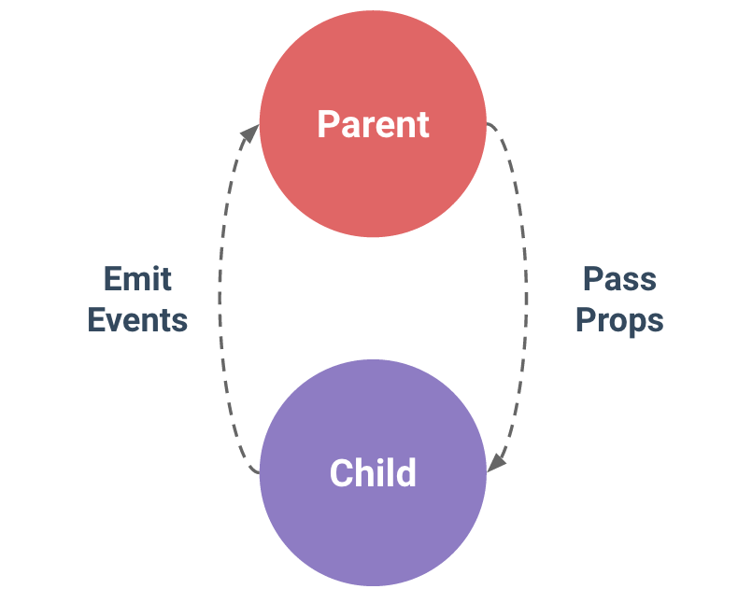
{Vue Components - Demo}
Powerful way to facilitate code reuse
Vue components are also Vue instances
Can register both globally and locally
The data object must be a function
Components can be composed
Components data is isolated from each other
Can communicate through well defined interfaces:
Props down
Events up
Notes:
Components are one of the most powerful features of Vue. They help you extend basic HTML elements to encapsulate reusable code. At a high level, components are custom elements that Vue’s compiler attaches behavior to.
All Vue components are also Vue instances, and so accept the same options object (except for a few root-specific options) and provide the same lifecycle hooks.
To register a global component, you can use Vue.component(tagName, options). You can also do this locally using the components instance option on a Vue instance.

Slide 25
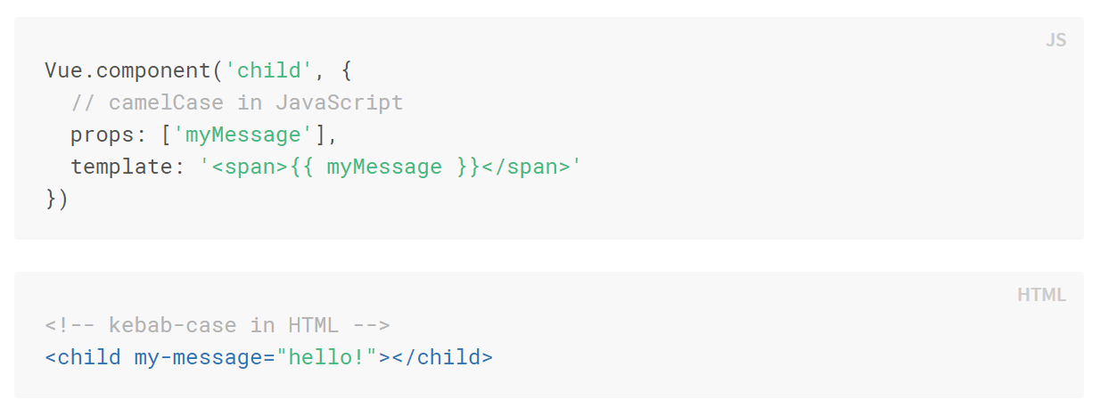
{Vue Props – Demo}
Used to pass data to children
Meant to be one-way although two-way is supported with .sync
Props can be set with local values or bound
Props can be validated
Camel vs Kebab casing

Slide 26
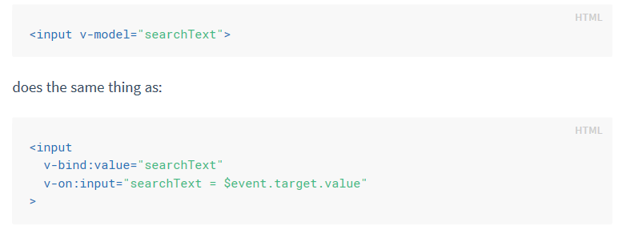
{Vue Custom Events – Demo}
Used to pass data to the parent
Listened for by with the v-on directive
Emitted using the $emit(‘eventName’, [param]) method
Events and Props can be used to support v-model

Slide 27

{Vue Lifecycle}
https://vuejs.org/v2/guide/instance.html#Lifecycle-Diagram
Notes:
Below is a diagram for the instance lifecycle. You don’t need to fully understand everything going on right now, but as you learn and build more, it will be a useful reference.
It is a very good place to go and check if you are stuck.

Slide 28

{Kendo UI for Vue}
Based on Kendo UI for jQuery
Implemented as Vue wrappers on top of the jQuery components
There are KendoUI wrappers for:
Angular.js
React
Server-side frameworks
Notes:
Can actually access the underlying kendo widget using .kendoWidget()
Implemented as plugins <Widget>Installer which do the heavy lifting

Slide 29

Data Source
Validation
Globalization
Templates
Drag & Drop
MVVM
Export
Components

Slide 30
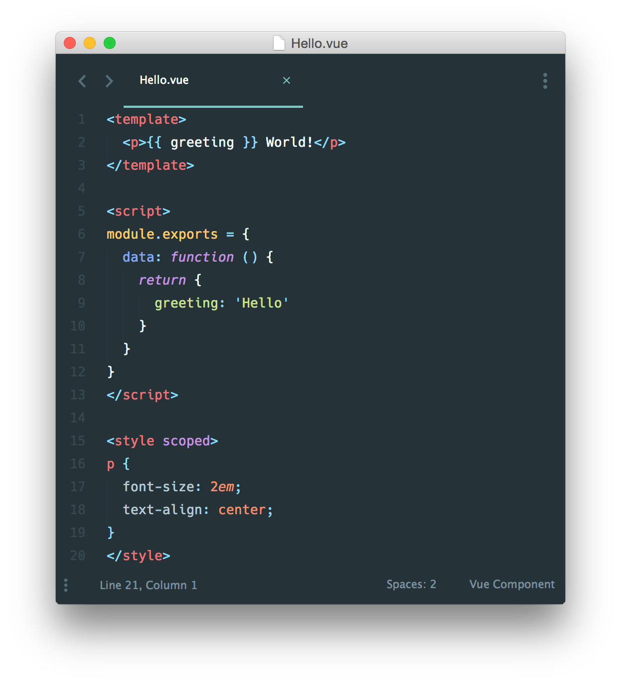
{Building real-world apps with Vue}
Vue is simply a library that facilitates MVVM
There are many other pieces in the Vue ecosystem
VueRouter provides routing capabilities
VueEx provides state management services
Single file components with Webpack
Setting up a project is convoluted
Vue CLI to the rescue!
npm install -g @vue/cli
Notes:
In many Vue projects, global components will be defined using Vue.component, followed by new Vue({ el: '#container' }) to target a container element in the body of every page.
This can work very well for small to medium-sized projects, where JavaScript is only used to enhance certain views. In more complex projects however, or when your frontend is entirely driven by JavaScript, these disadvantages become apparent:
Global definitions force unique names for every component
String templates lack syntax highlighting and require ugly slashes for multiline HTML
No CSS support means that while HTML and JavaScript are modularized into components, CSS is conspicuously left out
No build step restricts us to HTML and ES5 JavaScript, rather than preprocessors like Pug (formerly Jade) and Babel
All of these are solved by single-file components with a .vue extension, made possible with build tools such as Webpack or Browserify.
Now we get:
Complete syntax highlighting
CommonJS modules
Component-scoped CSS
We can also use preprocessors such as Pug, Babel (with ES2015 modules), and Stylus for cleaner and more feature-rich components.
What About Separation of Concerns?
One important thing to note is that separation of concerns is not equal to separation of file types. In modern UI development, the vue.js team have found that instead of dividing the codebase into three huge layers that interweave with one another, it makes much more sense to divide them into loosely-coupled components and compose them. Inside a component, its template, logic and styles are inherently coupled, and collocating them actually makes the component more cohesive and maintainable.

Slide 31
{Short Break}
Please take ~10 minutes to relax and recharge

Slide 32

{Live Code Demo}
We will build a real-world dashboard app together with the Vue CLI!

Slide 33

{Theme Builder}
URL: http://themebuilder.telerik.com/kendo-ui

Slide 34
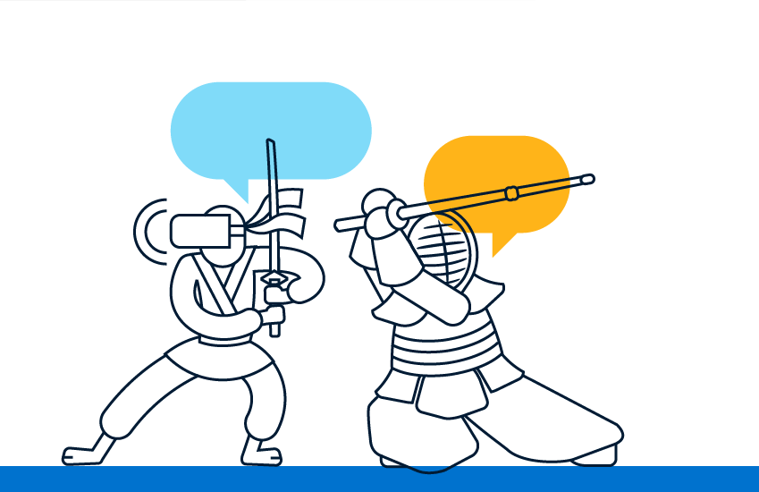
{Chatbots}
Knowledge and Transactional chatbots
Smart chatbots
Benefits
Cost savings
Automation of repetitive tasks
24/7
Scalable
Engaged users
Customer Satisfaction
Notes:
Chatbots are another area which we believe will gain more traction in the future.
2 types of bot… limited amount of specialized processes that replace the need to talk to a person or use complicated UIs
Not one likes stupid bots
Benefits
------------------------------------------------------------
There are generally two types of chatbots. We have all heard or used Alexa, Cortana, Siri and Google Assistant. These are the so called knowledge chatbots, which are trained on enormous amount of data and aim to help the user making a decision or providing the requested information. On the other hand, there are the transactional chatbots, whose purpose is to execute a limited amount of specialized processes that replace the need to talk to an expert, or to use complicated Uis such as long forms or processes. Think what a bank operator can do for you over the phone – verify identity, block stolen credit card, provide working hours for nearby branches, or help out with information about outgoing transfer. Other examples could be booking a doctor appointment, buy a vacation, food or insurance. All these, are very good cases for where a transactional chatbot can deliver value, by helping the customers 24/7 without the need for large operator teams to pick up the phone.
There is a catch though. No one likes, stupid chatbots, so it is very important to utilize Natural Language Understanding service and to train your bot properly, so your users never get blocked. A rule of the thumb is that a user using the chatbot should be able to finish their task faster than using other means (e.g. filling a form or a phone call).

Slide 35
{Conversational UI}
Easy to navigate and engaging
Cover web, mobile and desktop
Framework agnostic
Deliver natural conversation flow
Part of your app with same look and feel
No need for external channels
Notes:
Information presentation – easy to understand and engaging
Introduced conversational UI in W M D.
Framework agnostic, easy to use, aid natural conv flow, no need to another channel – use your app
Another thing that have to be considered is presentation of the information in a easy to understand, and engaging way. This is where we decided our expertise can help and we introduced the Conversational UI story across the board of all of our UI product lines to aid developers in the implementation of engaging chatbots, whether in mobile, desktop or web applications.
The Conversational UI components, are framework agnostic, which means, not matter which framework you utilize, you can use Conversational UI for your user experience. They are easy to implement and provide the means to deliver natural conversation flow and most importantly, you can embed these bots in your existing applications with the same look and feel and without the need to send your users to external channels such as facebook, skype, etc

Slide 36

{Resources}
Vue.js Documentation:
https://vuejs.org/v2/guide/
Vue.js API Reference
https://vuejs.org/v2/api/
Kendo UI for Vue Demos:
https://www.telerik.com/kendo-vue-ui/components/
Kendo UI Blog:
https://www.telerik.com/blogs/kendo-ui
New Venture Software’s Blog:
https://www.newventuresoftware.com/blog

Slide 37
{The End}
Thank you for attending the Progress Virtual Classroom!
This concludes today’s training. Feel free to submit any remaining questions and we will do our best to reach out to everyone.

